Slide 1
Welcome to SEUT Maritime AS
Office phone: +47 693 45 060 | Cell: + 47 936 67 387 | E- mail: torbjorn@seutmaritime.no | Web: seutmaritime.no | Sørkilen 8 | 1621 Fredrikstad | Norway |

Slide 2
Production
Seut Maritime AS.
We are located in central and up to date facilities in Fredrikstad.
Together with our Engineerng Company SAVEMA Engineering as.
Our workshop are placed in ground flor with very good internal and external accessibility.

Slide 3
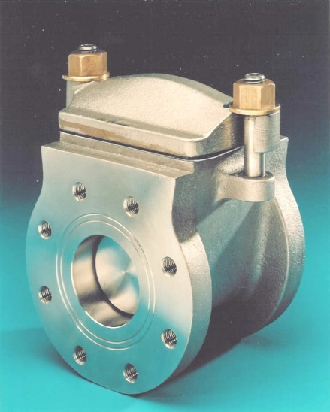
Blind valves SA2 - SA3 - SA4
We manufacture valves in:
A-216 WCB(Carbon steel SA-2).
AISI 317L(Stainless SA-3)
In SA-4(SA-2 house and AISI 316L inserts).
From DN50(2”) to DN750(30”).

Slide 4
Our CNC Milling Centre
Centre can machine/mill/drill and thread, from DN50 to DN500 PN25 with great accuracy and speed.

Slide 5
Office
Our office are located in 2. floor with online to our CNC machines regarding programming and supervision.

Slide 6
Our Managing Director Torbjørn Kjelvik
He have over 40-years experience from skip and offshore equipment.

Slide 7
Our Technical Department
Take care of all technical changes and updates for Production and Costumers.

Slide 8
Workshop
Our experienced crafts men also use manual milling machines where that will be rational i.e. small series and special requirements.

Slide 9
Cutting raw material goes automatically in our programmable cutting machine.
We deliver valves&spare parts with our own transport to Sea and Airports in Norway, we have 24 hours Spare Parts delivery World Wide.

Slide 10
We produce ca 2000pcs valves pr. year with help our CNC centres and skilled craftsmen.

